Slide 1

Cultural Task
Producto Ñ

Slide 2
Global objectives
To research the Spanish Speaking market.
To create a product that could potentially be sold in a Spanish Speaking country.
To create an advertisement for your product.
To present your product to the rest of the class.

Slide 3
Rules for effective teamwork
We play our role effectively
We respect and listen to our classmates when contributing to class discussion
We listen to other people’s ideas and suggestions
We stick to the time limits and deadlines
We help others as this will make us, our team and our class be successful

Slide 4
Teams
You will be working in groups of 3-4.
You need to appoint a:
  “Project Manager”. They will be in charge of making sure everything is done correctly and each person has a task to do.
  “Spokesperson”. They will explain the results of your research to the rest of the class. They will also explain how the members of the group have contributed to the discussion.
  “Resource monitor”. They will make sure the team has all the resources they need.
  “PR”. They have to make sure everyone contributes when all members of the group explain their findings. They are the only ones allowed to communicate with other PRs in other teams.

Slide 5
Lesson 1:
Starter: What do you expect to learn?
Task:
  Do some research on any Spanish Speaking country you are interested in.
  Include:
    Facts about the country (climate, sports, food, habits, technology…)
    Does it have any links with the UK? (historical, commercial…)
Fill in your assessment form.

Slide 6
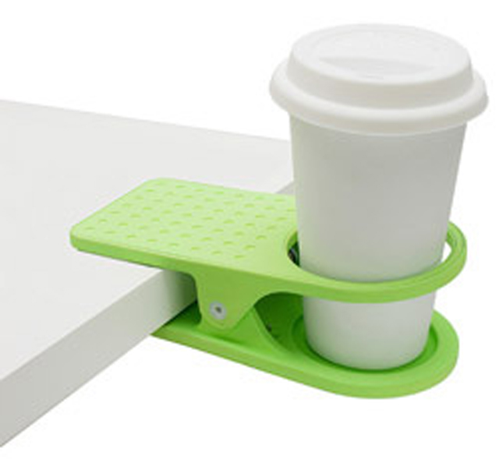
Lesson 2:
Starter: what does this product suggest you?
Task:
  Now you need to decide what type of product you would like to create and why.
  Use real facts to support your ideas! – e.g. percentages
    I think my product would be successful in ______ because I have discovered that _____% of people ___________.
Start designing your first draft on a piece of paper or a computer.
Fill in your assessment form.

Slide 7
Lesson 3:
Starter: take your draft. How would you use your product?
Task:
  Create a prototype of your product. It can be physical or digital.
Fill in your assessment form.

Slide 8
Lesson 4:
Starter: Post-it activity. What have you learnt or enjoyed the most?
Task:
  Your teacher will show you digital and physical tools to help you work on your advertising.
  Explore one of them.
  Use one you know and tell the rest of your team about it.
Fill in your assessment form.
Notes:
Some digital tools: https://list.ly/list/17JB-recursos

Slide 9
Lesson 5:
Starter: watch the videos and talk about your own ideas.
Create an advertisement for your product:
  Think of the content of your advertisement – catchy phrase, colours, layout.
  Think of the format – paper, digital, video, recorded track.
  The advertisement needs to be well planned! – storyboard for video, script for recorded track, different drafts for paper and digital version…
Fill in your assessment form.

Slide 10
Lesson 6:
Starter: talk to your partner and then the rest of your team about what you have learnt up to know.
Create a presentation and send it to your teacher. Don’t forget to include:
  Product – and explanation
  Advertisement
Fill in your assessment form.

Slide 11
Lesson 7:
Present your work!
Explain the Business and Enterprise skills you have used in the whole project.

